Slide 1

Multiple Access Control-II
Lecture (Theory)

Slide 2
Index
,
Concept Multiple Access Resolution
Control Access
Reservation Polling Token Passing
PiggyBacking

Slide 3
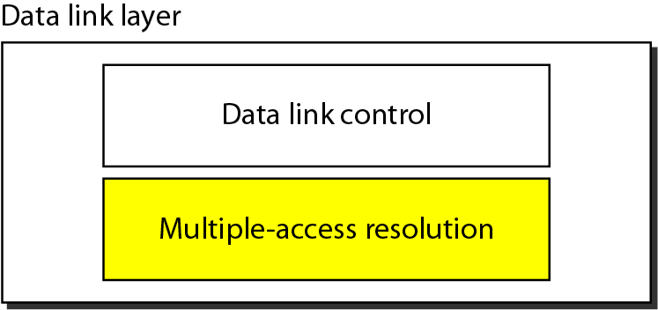

Slide 4
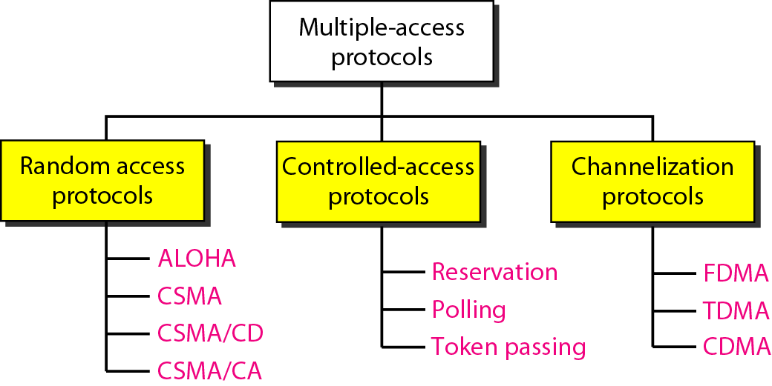

Slide 5
CONTROLLED ACCESS
In controlled access, the stations consult one another to find which station has the right to send. A station cannot send unless it has been authorized by other stations. We discuss three popular controlled-access methods.

Slide 6
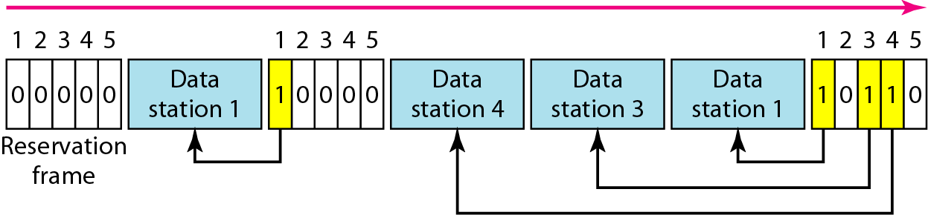
Reservation access method
Figure 1 Reservation access method

Slide 7
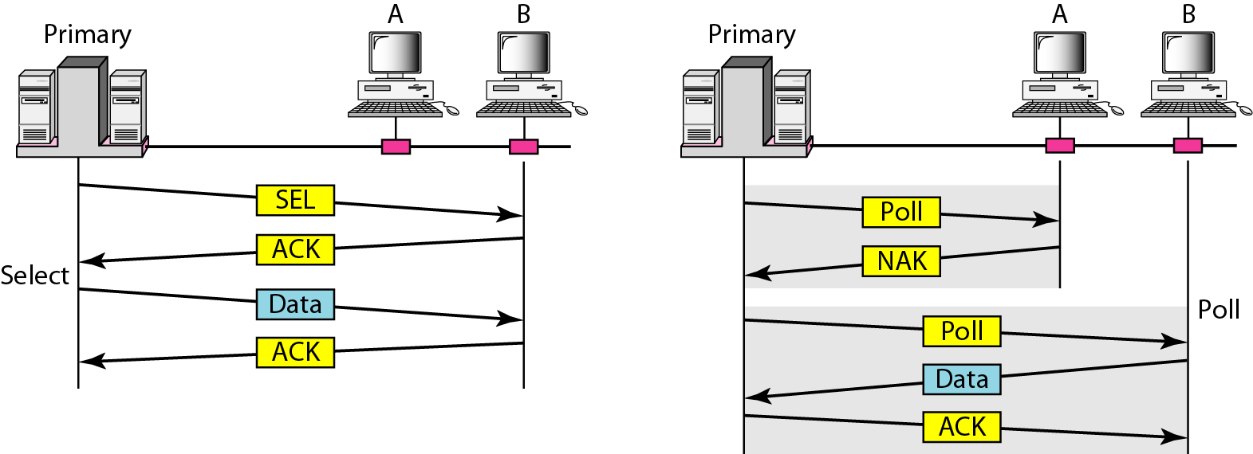
Select and poll functions in polling access method
Figure 2 Select and poll functions in polling access method

Slide 8
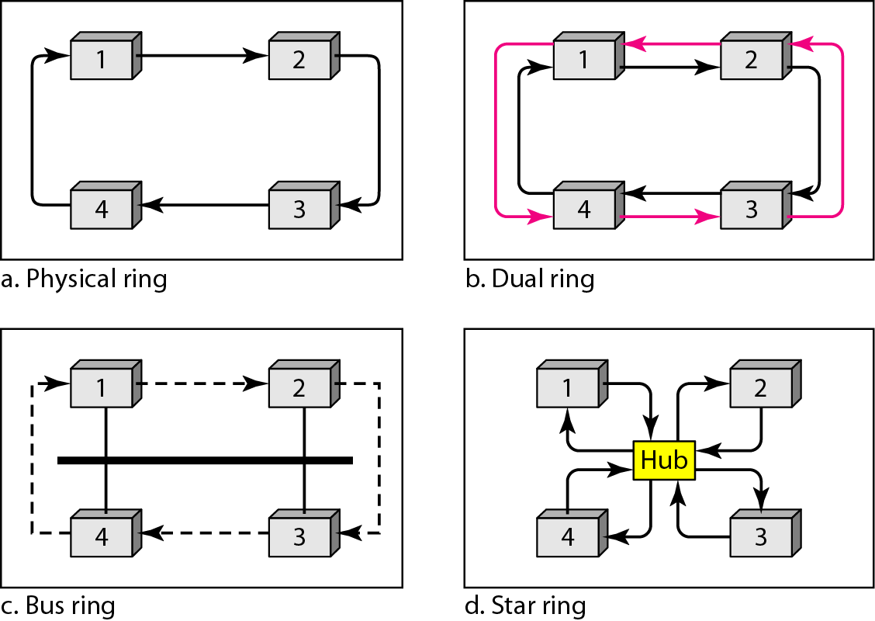
Logical ring and physical topology in token-passing access method
Figure 3 Logical ring and physical topology in token-passing access method

Slide 9
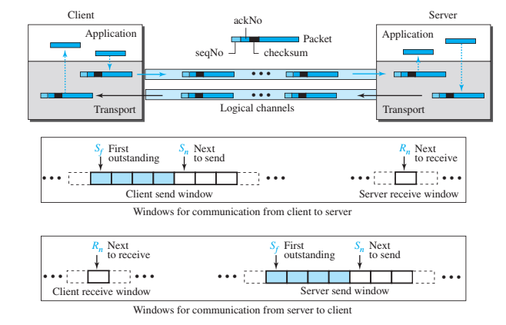
Piggybacking
﻿The client and server each use two independent windows: send and receive.

Slide 10
Practice Questions
https://pinoybix.org/2017/07/mcq-in-network-layer-internet-protocol-forouzan.html
https://edurev.in/course/quiz/attempt/-1_Test-Ipv4--IP-Packet/0decdb37-7206-4824-afdd-d47013a5c4cd

